Slide 1

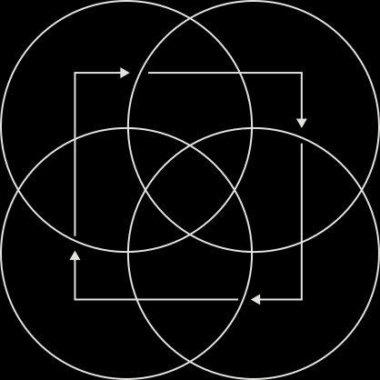

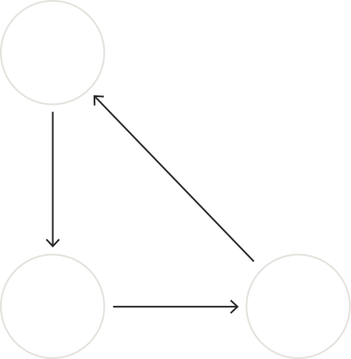
Exploring Nature-Inspired Algorithms
Ant Colony Optimization Algorithm

Slide 2
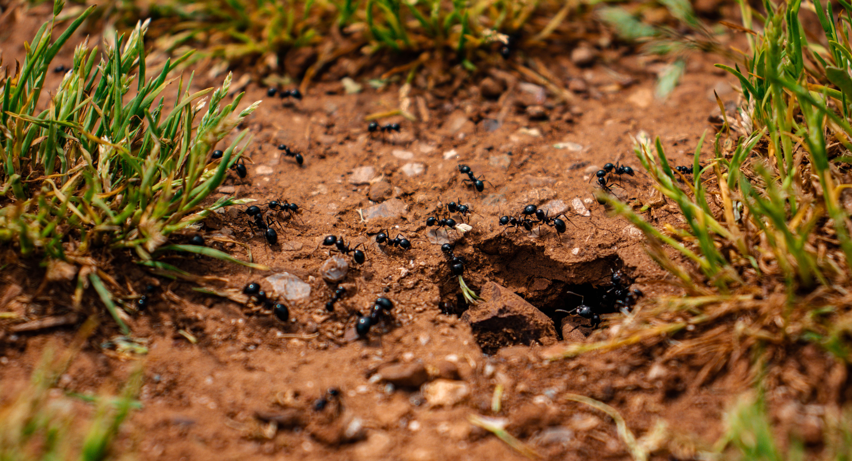


Understanding Ant Behavior
Inspired by nature's efficiency
Our algorithm mimics real ant foraging behavior to solve complex optimization problems effectively and efficiently.

Slide 3

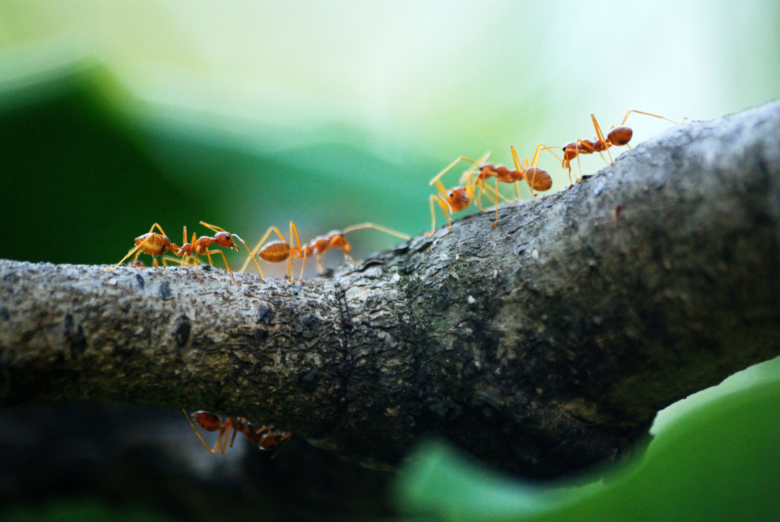
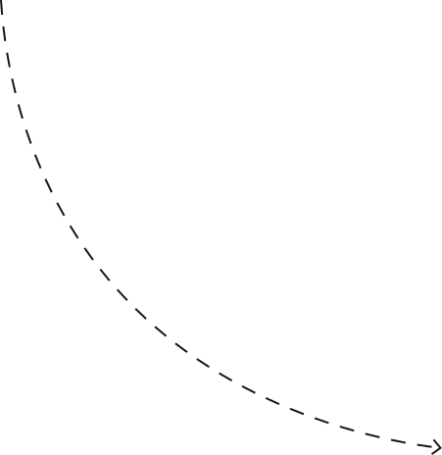
Key Methodology of ACO
01
Pheromone Trails
Pheromone trails guide ants in finding optimal paths to food sources, influencing decision-making in the colony.
02
Heuristic Information
Heuristic information helps ants evaluate paths based on experience, improving the efficiency of the search process.
03
Pheromone Evaporation
Pheromone Evaporation helps ants avoiding long paths being selected or getting stuck at locally optimal solution

Slide 4

STEP 1
STEP 2
Initialize pheromone levels and set parameters.
Ants construct solutions based on pheromone trails.
STEP 3
STEP 4
Evaluate solutions and update pheromone levels accordingly.
Identify the best solution and finalize results.

Slide 5

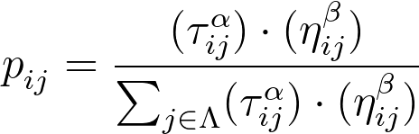
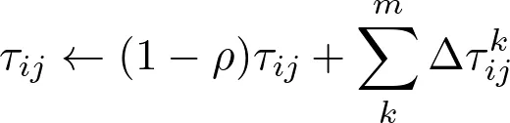
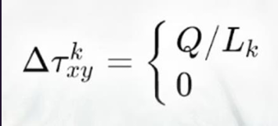
Used Mathimatical Equations
Choosing next city using probability
τ: The amount of pheromone deposited on the edge
η: The travel cost (heuristic) of the edge
α 𝛽: Are parameters that control the influence of pheromone and heuristic information
Updating Pheromone
ρ: The rate of pheromone evaporation
If ant K took the curve xy
Otherwise

Slide 6
Algorithm Analysis
Average runtime for 10 Cities: 2.88 seconds
Runtime breakdown by ant count:
1 Ants: 2.74 seconds
5 Ants: 3.34 seconds
10 Ants: 2.55 seconds
Average runtime for 20 Cities: 2.27 seconds
Runtime breakdown by ant count:
1 Ants: 2.24 seconds
5 Ants: 2.04 seconds
10 Ants: 1.99 seconds
20 Ants: 2.78 seconds
Best result for 10 cities: 152.00
Best result for 20 cities: 146.00

Slide 7
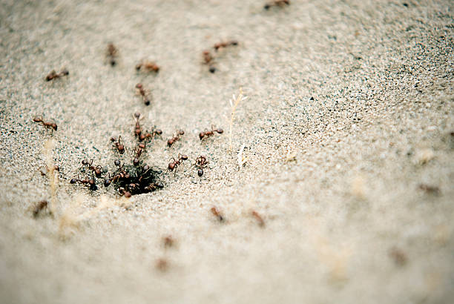
Conclusion
ACO is a metaheuristic approach for solving NP hard optimization problems
ACO efficiently solves TSP by reaching a near-optimal solution
It has been successfully applied to a wide range of optimization problems, including scheduling, routing, and resource allocation

